Slide 1


Slide 2

NutriVis - Visualizing Nutritional Profiles of Foods

Slide 3
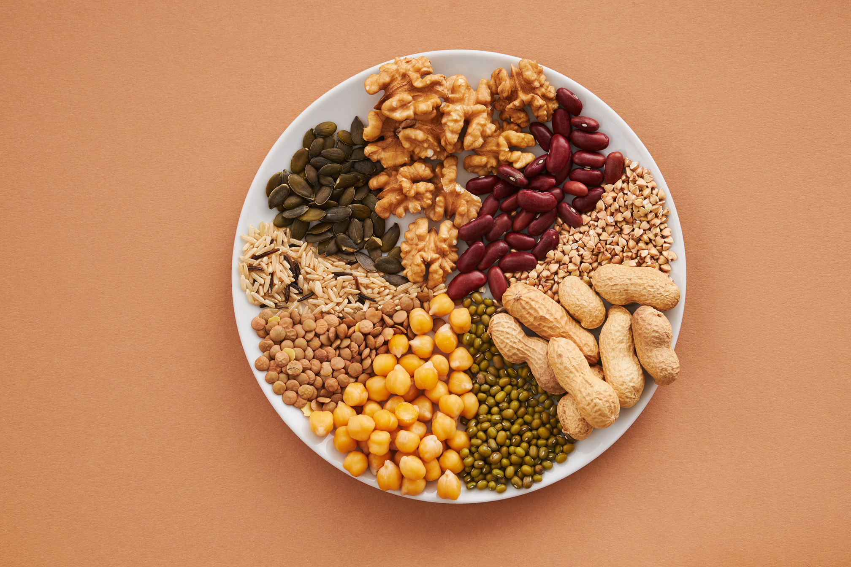
The Team
Steph Adey
Sonal Bhosle
Liwei Jiang
Aryan Linga

Slide 4
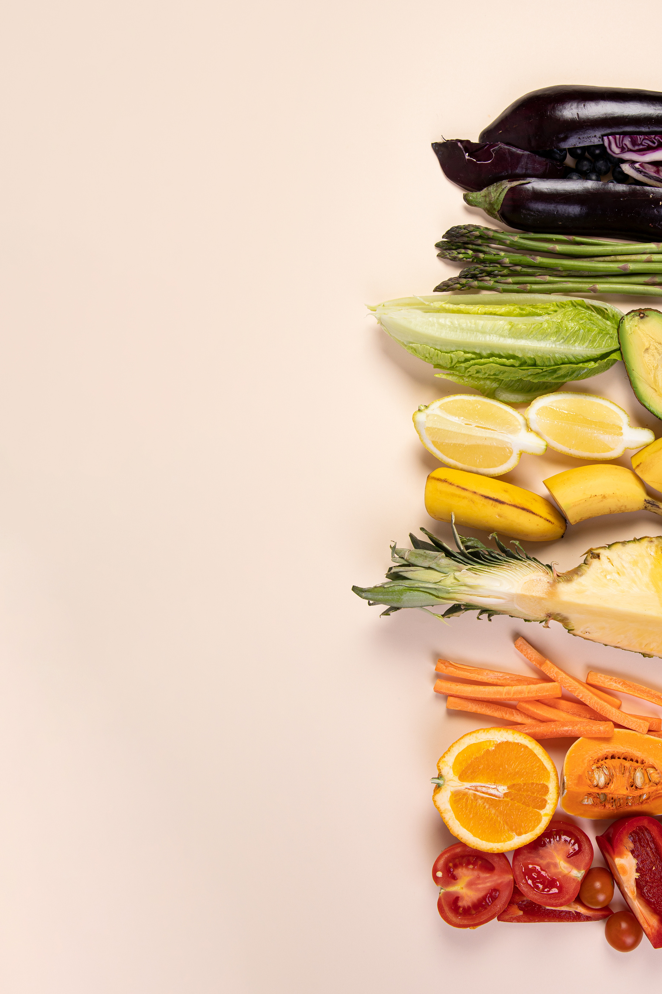
Data
•Original data consists of 8787 items of food extracted (E) from data.world (https://data.world/awram/food-nutritional-values/workspace/file?filename=ABBREV.xlsx)
•
•Transformation (T) of the original data was performed based on the descriptions, the food items have been categorised into 8 common categories: Dairy, Fruits, Grains, Meats, Nuts & Seeds, Seafood, Vegetables, and others.
•A final sample of 700 items were selected which consists of 100 for each category(sorted by values in descending order) above except for the broad category “others”.
•
•Both the original dataset and the final sample of 700 food items are then exported as csv and json files and loaded (L) to MongoDB database to store and/or use when needed before the analyses are performed.

Slide 5

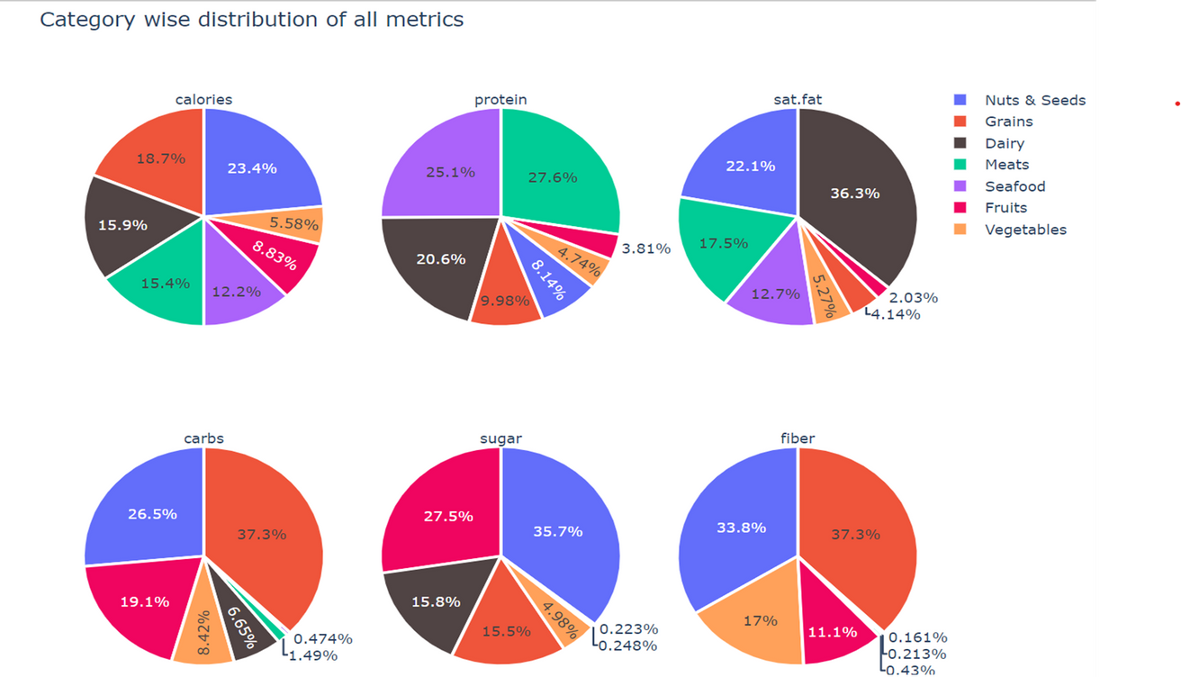
Average nutrition values by category

Slide 6
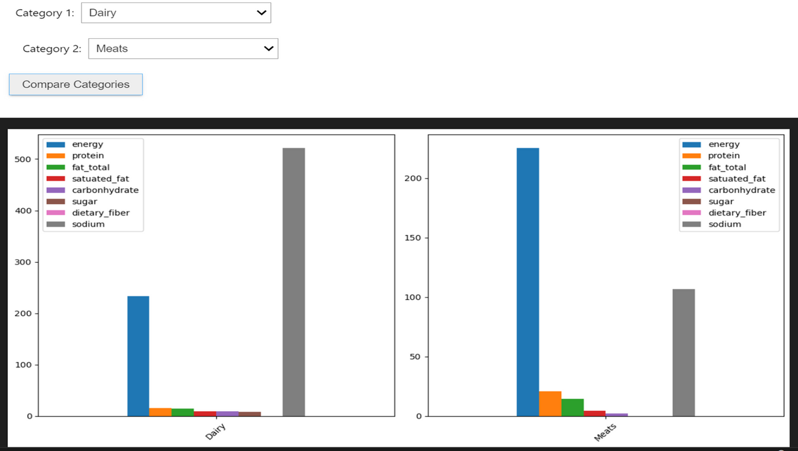
Comparison of nutrition values between two selected categories

Slide 7
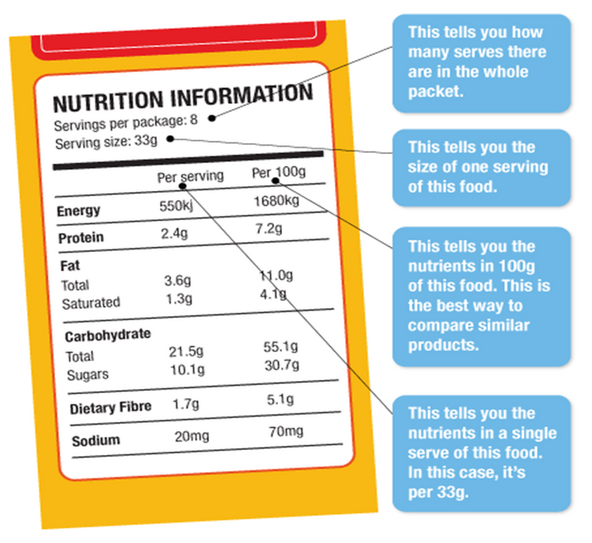
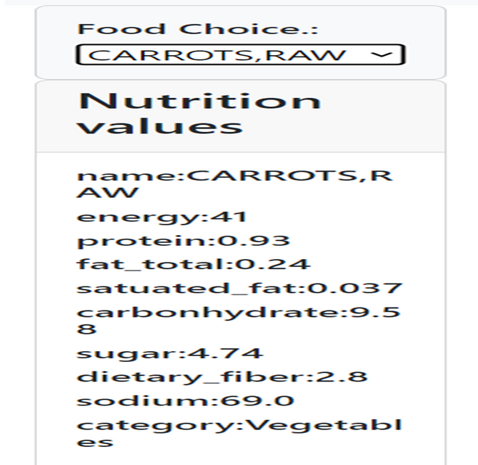
Example of generated food label

Slide 8
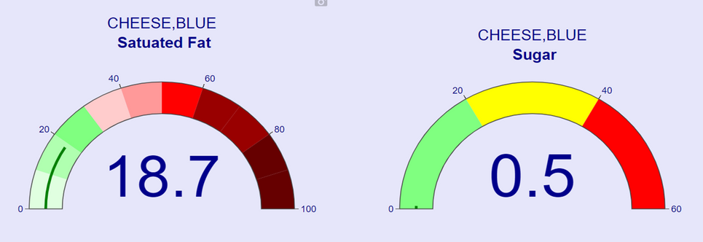
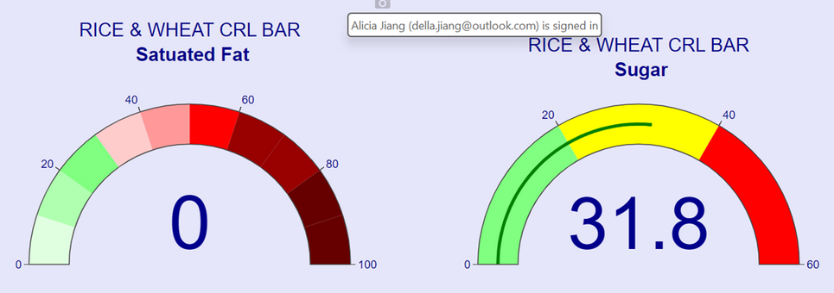
Gauge charts

Slide 9
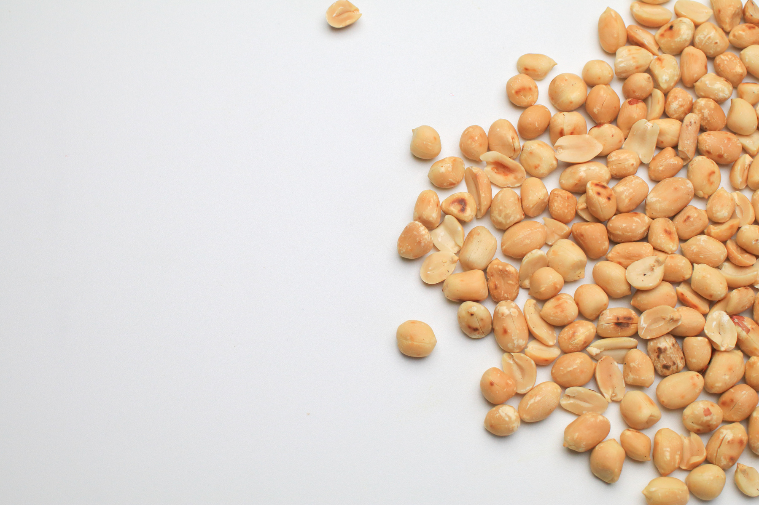

Slide 10
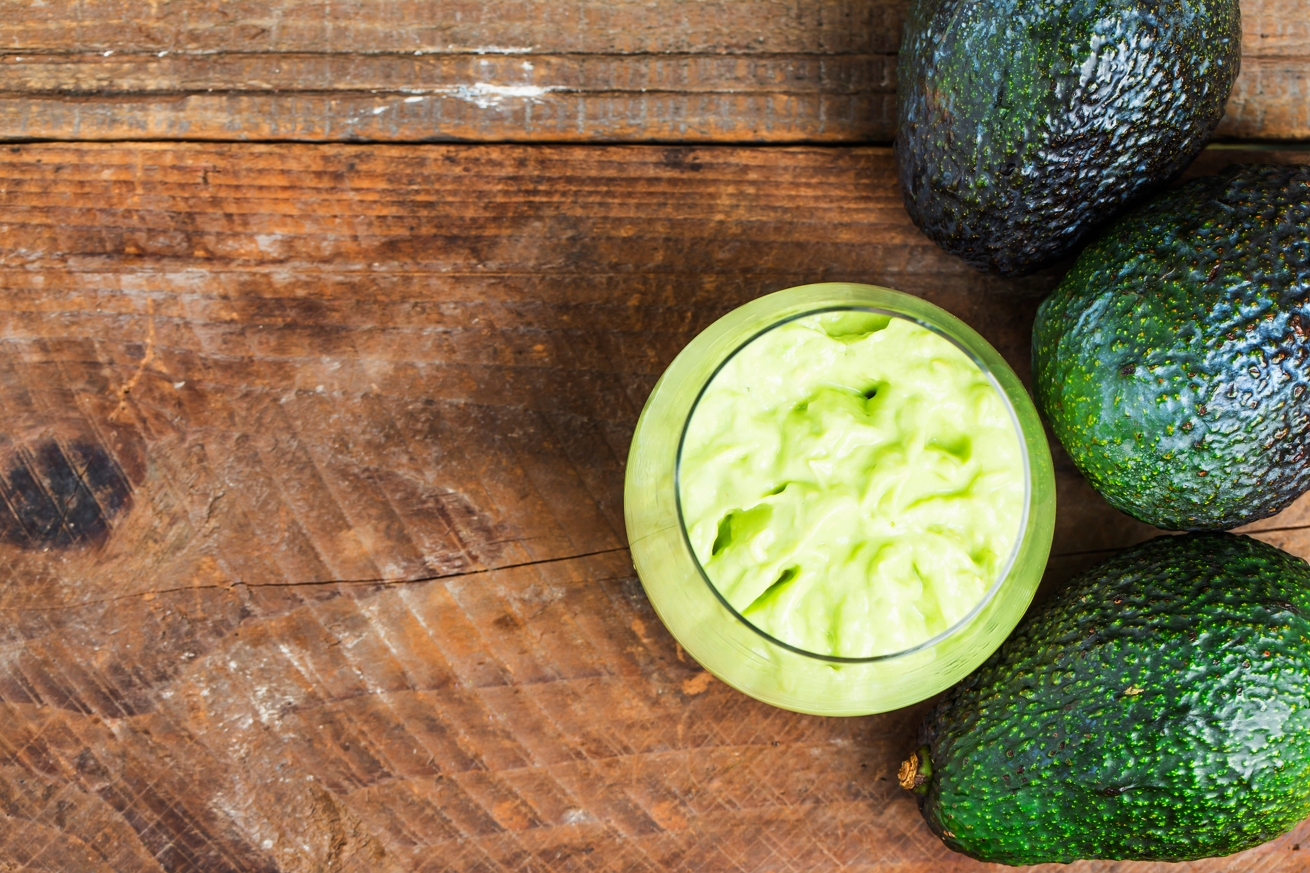
Q & A

Slide 11
THANK YOU!

